Slide 1
MODULE 4
Faizal K
Asst. Professor
Dept: of Mechanical Engineering
School of Engineering, CUSAT

Slide 2
Marketing

Slide 3
Definition
Marketing is the economic process by which goods and services are exchanged between the producer and the consumer and their values determined in terms of money.
It’s a total system of interacting business designed to plan, promote and distribute need-satisfying products and services to existing and potential consumers.
Marketing starts with the identification of a specific need on the part of the consumer and ends with the satisfaction of that need.

Slide 4
Concept of Marketing Vs Selling
The marketing concept gives importance to consumers and the concept holds that the key to achieving organizational goal consists in determining the needs and wants of customers and delivering the desired satisfaction.
The selling concept is product-oriented and the concept holds that the consumers normally will not buy enough of the organizations products and therefore efforts must be made to force the customers to buy the products.

Slide 5
Selling | Marketing
1. Product Oriented | Customer oriented
2. Emphasis on company (seller) needs | Emphasis on customer’s need
3. Company oriented selling efforts | Market oriented selling efforts
4. Goods are already produced and then sold at profit | Customer demand determines production
5. Selling aims at short term objectives | Aims at long term objectives

Slide 6
Marketing System
Input :- Product, price, place and promotion (Marketing Mix).
Processor:- business organisation.
Output:- Sale of goods
Controller
Objective:- Profit/Customer satisfaction

Slide 7
Market segmentation
Market segmentation is defined as “ taking the total heterogeneous market for a product and dividing it into several segments, each of which tends to be homogeneous in full significant aspects.
It consist of grouping of consumers according to such characteristics as income, age, taste for a product etc.

Slide 8
Types/methods of Market segmentation
Geographic Segmentation:- Based on region, continent, country, climate of area etc.
2. Demographic Segmentation:- Based on age of customers, family size, religion, community, occupation etc.
3. Psychographic Segmentation:- Based on personality types, lifestyles etc.

Slide 9
Buyer behaviour Segmentation:- Different customer groups expect different benefits from the same product and as such their motivations in owing it and their behaviour in buying it will be different.
5. Volume Segmentation:- Based on quantity of purchase or the potential quantity of purchase.

Slide 10
Pricing
Price refers to the exchange value of a product or a service.
One of the most important tasks of a marketing manager is pricing.
Unless the product is priced properly, all other elements of marketing mix may be rendered ineffective.

Slide 11
The key factors to be considered in pricing are:
1) Nature and extent of consumer demand
2) Total cost associated with the product
3) Legal aspects
4) Prices for similar products offered by competing firms
5) General economic conditions
6) Type of customers
7) Method of promotion
8) Distribution channels
9) Life cycle of the product
10) Profit considerations

Slide 12
Pricing Methods
The two common methods of pricing are:
(a) Cost plus approach
(b) Market or demand approach
(a) Cost Plus Approach:- this approach is one of the commonly used methods of pricing. In this method total cost associated with production, selling and distribution are added with the desired profit.
i.e. Product Price = Fixed Cost per Unit + Variable Cost per Unit + Profit margin

Slide 13
(b) The Market or Demand Approach:
In this method of pricing, prices are not based on the total cost but allow the market forces (supply and demand) to determine the product price.

Slide 14
Pricing Methods
The two common methods of pricing are:
(a) Cost plus approach
(b) Market or demand approach
(a) Cost Plus Approach:- this approach is one of the commonly used methods of pricing. In this method total cost associated with production, selling and distribution are added with the desired profit.
i.e. Product Price = Fixed Cost per Unit + Variable Cost per Unit + Profit margin

Slide 15
(b) The Market or Demand Approach:
In this method of pricing, prices are not based on the total cost but allow the market forces (supply and demand) to determine the product price.

Slide 16
Consumer market Vs Industrial markets
Industrial Marketing: It refers to the sale of either products or services or both by one organization to other organizations that further resell the same or utilize to support their own system.
Consumer Marketing: on the other hand refers to the transaction of goods and services between organizations and potential customers.
Industrial/Business marketers do not entertain consumers who purchase products and services for their end-use. They deal only with other businesses/firms to sell their products.
In consumer markets, products are sold to consumers either for their own use or use by their family members.

Slide 17
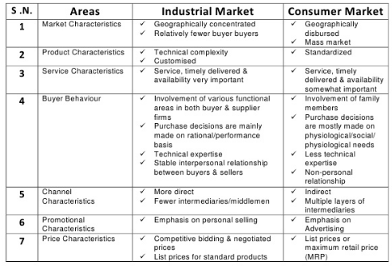

Slide 18
Sales promotion
All the activities that go into the development of sales or those that are intended to raise the demand level for a product very quickly can be termed as sales promotion.
The idea behind sales promotion is to bring the name of product and that of the manufacturer constantly before wholesalers, retailers and the consumers in order to stimulate the interest in the product.

Slide 19
Methods of Sales Promotion
1) Consumer Promotion: Persuading consumers to buy; these include samples, money refund offers, prices-off, trading stamps, contest and competitions, etc.
2) Trade Promotion: Giving incentives to distributors and others to hold stocks of company products.
3) Sales Force Promotion: Offering bonuses, contests etc. for the salesmen.
4) Good Public Relations: Developing goodwill among general public and boosting sales.

Slide 20
(5) Display: Displays at the point of sale, using posters, banners, placards and leaflets, to attract the customers’ attention to the product.
6) Good Customer Relations: Good customer relations are basically the result of the past transactions with the company.
Speedy handling of complaint, assistance in emergencies, abiding by announced policies, etc. all develops good customer relations and increase future sale of company products.
7) Product exhibitions, demonstrations, and conferences.
8) Latest product styling and appealing product packaging catch the eye of the consumer and develop sales volume.

Slide 21
Physical Distribution/Channels of Distribution
A channel of distribution is the route that the product follows in its passage from the producer to the consumer.
Factors affecting this route are:
1) Nature of good
2) Nature and location of the markets
3) Price of the product
4) Availability of middlemen, transportation
5) Sales effort required by the middlemen, and
6) Resources of the manufacturer

Slide 22
Channel management mainly deals with two problems:
1) Channel selection
2) Maintaining the channel

Slide 23
Channel selection:
Three policy alternatives may be considered in the selection of the channel:
The policy of general or intensive distribution whereby the firm seeks to obtain the widest possible distribution for its product by allowing it to be sold everywhere by anyone willing to stock it.
b) The policy of selective distribution, where the manufacturer chooses only those outlets that are best able to serve that company’s needs.
c) The policy of using exclusive dealerships, which allows only one distributor to stock and sell the product in a given market.

Slide 24
2) Maintaining the channel:
It constitutes of 3 aspects:
a) Ensure that the terms of contract are followed by all parties.
b) Maintain good relations with the middlemen and encourage them to cooperate fully.
c) Represent his company to the middlemen by seeing that sufficient cooperation and assurance are provided.

Slide 25
Advertising
Advertising is any form of paid non-personal presentation of ideas, goods or services for the purpose of inducing people to buy.
In short, “advertising is salesmanship without a personal salesman”.

Slide 26
Objectives
1) Providing general information about the existence of the product.
2) Providing technical information about its functional characteristics or utilitarian purposes.
3) Drawing the customers’ attention to those attributes of the product which he wants.
4)Winning undecided customers by exhibiting possible attractions (such as colour, design, novelty and price) that may persuade him to prefer the product to one offered by competitors.
5) Creating demand among a passive population of customers.
6) Educating the customer, or telling him what he should want.

Slide 27
Entrepreneurship development

Slide 28
Entrepreneur..??
An entrepreneur is defined as “person in effective control of commercial undertaking; one who undertakes a business or an enterprise”.
Entrepreneur is an innovative person who maximizes his profits by following new strategies or venturing into new products or services.

Slide 29
Entrepreneurship..??
Entrepreneurship is the act of being an entrepreneur, who starts any economic activity for being self-employed.
Entrepreneurship is the “process of the entrepreneur”. It is an attempt to create value through recognition of business opportunity. It is basically communicative and management functions to mobilize financial and material resources.
The entrepreneurial activity is governed by varying combination of socio-economic, psychological, cultural and other factors: Caste/religion, Family background, Level of education, Level of perception, Occupational background etc.

Slide 30
Entrepreneurial characteristics
Being an entrepreneur requires specific characteristics and skills that are often achieved through education, hard work, and planning.
Risk Taker
Businesses face risk. Entrepreneurs minimize risk through research, planning, and skill development.
Perceptive
Entrepreneurs view problems as opportunities and challenges.
Curious
Entrepreneurs like to know how things work. They take the time and initiative to pursue the unknown.

Slide 31
Imaginative
Entrepreneurs are creative. They imagine solutions to problems that encourage them to create new products and generate ideas.
Persistent
True entrepreneurs face bureaucracy, make mistakes, receive criticism, and deal with money, family, or stress problems. But they still stick to their dreams of seeing the venture succeed.
Goal-setting
Entrepreneurs are motivated by the excitement of staring a new business. Once achieved, they seek out new goals or ventures to try.
Hardworking
Entrepreneurs need a great deal of energy to see a venture start and succeed. Yet they are not deterred by the long hours to achieve their goal.

Slide 32
Self-confident
Entrepreneurs believe in themselves. Their self-confidence takes care of any doubts they may have.
Flexible
Entrepreneurs must be flexible in order to adapt to changing trends, markets, technologies, rules, and economic environments.
Independent
An entrepreneur’s desire for control and the ability to make decisions often makes it difficult for them to work in a controlled environment.

Slide 33
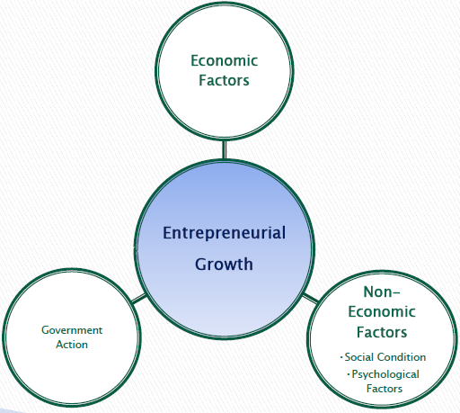
Factors affecting Entrepreneurship development

Slide 34
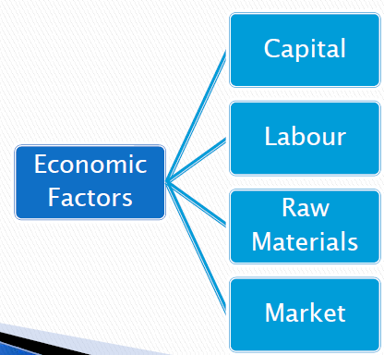
Economic Factors
From a strictly economic viewpoint, it can be said that the same factors which promote economic development account for the emergence of entrepreneurship also.

Slide 35
Capital:
Capital is one of the most important prerequisites to establish an enterprise.
Availability of capital facilitates the entrepreneur to bring together the land of one, machine of another and raw material of yet another to combine them to produce goods.
Capital is therefore, regarded as lubricant to the process of production/render services.
Labour:
The quality rather quantity of labour in another factor which influences the emergence of entrepreneurship.

Slide 36
Raw Materials:
The necessity of raw material hardly needs any emphasis for establishing any industrial activity and therefore it influences in the emergence of entrepreneurship.
In the absence of raw materials, neither any enterprise can be established nor an entrepreneur can emerged.
Market:
The fact remains that the potential of the market constitutes the major determinant of probable rewards from entrepreneurial function.
The size and composition of market both influence entrepreneurship in their own ways.

Slide 37
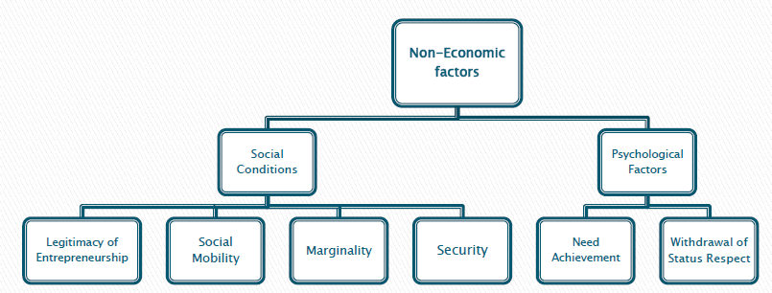
Non Economical Factors

Slide 38
Social Conditions
Legitimacy of Entrepreneurship: The proponents of non-economic factors give emphasis to the relevance of a system of norms and values within a socio-cultural setting for the emergence of entrepreneurship.
Social Mobility: Social mobility involves the degree of mobility, both social and geographical, and the nature of mobility channels within a system.
Marginality:
A group of scholars hold a strong view that social marginality also promotes entrepreneurship.
Individuals or groups on the perimeter of a given social system or between two social systems provide the personnel to assume the entrepreneurial roles.
Security:
Security is a significant factor for entrepreneurial development.
If individuals are fearful of losing their economic assets or of being subjected to various negative sanctions, they will not be inclined to increase their insecurity by behaving entrepreneurially.

Slide 39
Psychological Factors
Need Achievement:
According to David Mcclelland’s psychological theory of need achievement, a constellation of personality characteristics which are indicative of high need achievement is the major determinant of entrepreneurship development.
If the average level of need achievement in a society is relatively high, one would expect a relatively high amount of entrepreneurship development in the society.
Withdrawal of Social Respect:
Hagan believes that the initial condition leading to eventual entrepreneurial behaviour is the loss of status by a group.
He postulates that four types of events can produce status withdrawal:
It may drift into situation of status inconsistency; and
It may mot be accepted into expected status on migration in a new society.
The group may be displaced by force;
It may have its valued symbols denigrated

Slide 40
Government action
The government by its actions or failure to act also does influence both the economic and non-economic factors for entrepreneurship development.
Any interested government in economic can help, through its clear expressed industrial policy, promote entrepreneurship in one way or other, by creating basic facilities, utilities and services and by providing incentives and concessions.
The government can provide the prospective entrepreneurs a facilitative socio-economic setting. Such conductive setting minimizes the risks which the entrepreneurs are to encounter.
The supportive actions of the government appears as the most conductive to the entrepreneurial growth.

